Slide 1

JOHN HOLLAND'S SIX PERSONALITY TYPES THEORY
A Framework for Understanding Career Interests
Mohamed Al-Soufie
Mohamed Ahmed Saad
Abdulrahman Mahdy
Mostafa Sayed
2nd Jan - 2025
1

Slide 2

AGENDA
Introduction
John Holland’s Theory
Holland’s Hexagon
Personality Types
The Holland Code
Using Your Holland Code
Limitations of Holland’s Theory
Conclusion
2

Slide 3

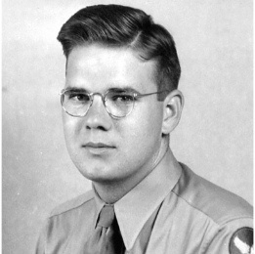
INTRODUCTION
Who is John Holland?
John Holland was a psychologist who changed career counseling by creating a theory about different personality types and how they fit with various work environments.
Developed the Holland Code (RIASEC) in the 1950s.
Believed that people flourish in careers that match their personality.
His theory is widely used in career assessments and guidance today.
3

Slide 4
JOHN HOLLAND'S THEORY
A model of career choice based on personality types and work environments.
People are more likely to be satisfied in work environments that match their personality type.
The Six Personality Types:
Realistic: Doers
Investigative: Thinkers
Artistic: Creators
Social: Helpers
Enterprising: Persuaders
Conventional: Organizers
4

Slide 5
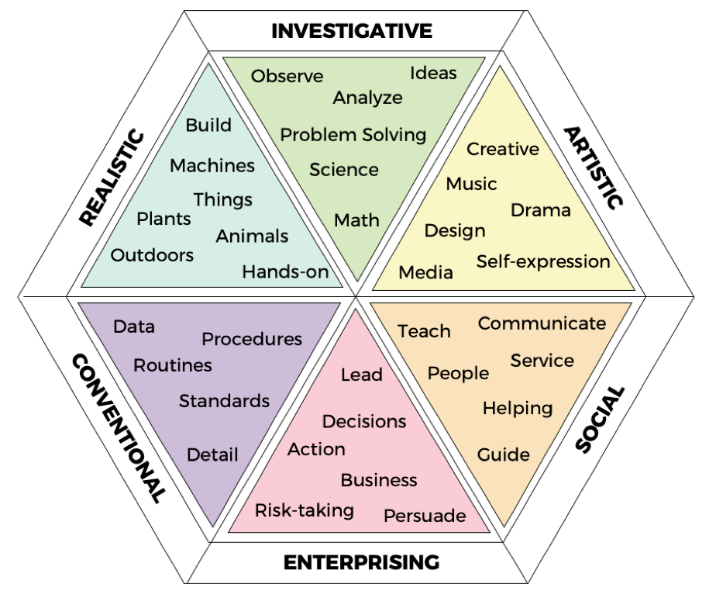
Holland’s Hexagon (RIASEC)
The six personality types are arranged in a hexagon.
Adjacent types are more similar than opposite types.
5

Slide 6

PERSONALITY TYPES
Realistic (R): Doers, Practical, Hands-on
Characteristics:
Prefer working with tools and machines
Enjoy physical activity and outdoor work
Value direct and tangible results
May be less interested in social interaction
Potential Careers:
Mechanic
Construction
Worker
Plumber
Electrician
Farmer
6

Slide 7

PERSONALITY TYPES
Investigative (I): Thinkers, Curious, Analytical
Characteristics:
Enjoy scientific exploration and research
Prefer working with ideas and concepts
Value intellectual stimulation and problem-solving
May be less interested in routine or repetitive tasks
Potential Careers:
Scientist
Engineer
Researcher
Programmer
Doctor
7

Slide 8

PERSONALITY TYPES
Artistic (A): Creators, Imaginative, Expressive
Characteristics:
Enjoy creative and self-expression
Prefer unstructured and flexible work environments
Value originality and nonconformity
May be less interested in rules and regulations
Potential Careers:
Artist
Musician
Writer
Actor
Designer
8

Slide 9

PERSONALITY TYPES
Social (S): Helpers, Caring, Cooperative
Characteristics:
Enjoy helping others and building relationships
Prefer working with people and in team settings
Sees self as helpful, friendly, and trustworthy.
May be less interested in competition or confrontation
Potential Careers:
Teacher
Nurse
Counselor
Social Worker
Therapist
9

Slide 10

PERSONALITY TYPES
Enterprising (E): Persuaders, Leaders, Ambitious
Characteristics:
Enjoy influencing and persuading others
Prefer positions of power and authority
Values success in politics, leadership, or business
May be less interested in detailed work or routine
Potential Careers:
Manager
Salesperson
Lawyer
Politician
Entrepreneur
10

Slide 11

PERSONALITY TYPES
Conventional (C): Organizers, Detail-oriented, Practical
Characteristics:
Enjoy working with data and following procedures
Prefer structured and organized work environments
Value accuracy and efficiency
May be less interested in ambiguity or uncertainty
Potential Careers:
Accountant
Bookkeeper
Secretary
Data Entry
Clerk
Financial Analyst
11

Slide 12
THE HOLLAND CODE
Holland Code Combinations:
Most people are a combination of two or three dominant types.
This creates a more nuanced understanding of your personality and career preferences.
Example:
Someone with a Social-Artistic-Enterprising (SAE) code might enjoy a career in marketing, public relations, or event planning.
12

Slide 13
USING YOUR HOLLAND CODE
Explore careers that align with your code.
Identify your strengths and weaknesses.
Make informed decisions about your education and career path.
Find work environments that complement your personality.
Holland Code Examples:
Engineer: RIA (Realistic, Investigative, Artistic)
Teacher: SEA (Social, Enterprising, Artistic)
Nurse: SRA (Social, Realistic, Artistic)
13

Slide 14
LIMITATIONS OF HOLLAND'S THEORY
May not capture the full complexity of personality.
Doesn't account for all career factors (e.g., skills, interests, values).
Cultural Bias:
May not be applicable to all cultures.
Static Nature:
Doesn't account for personality changes over time.
14

Slide 15
CONCLUSION
Holland's theory provides a valuable framework for understanding career interests.
Matching your personality type to your work environment can lead to greater job satisfaction.
Self-assessment and career exploration are essential for making informed career decisions.
15

Slide 16
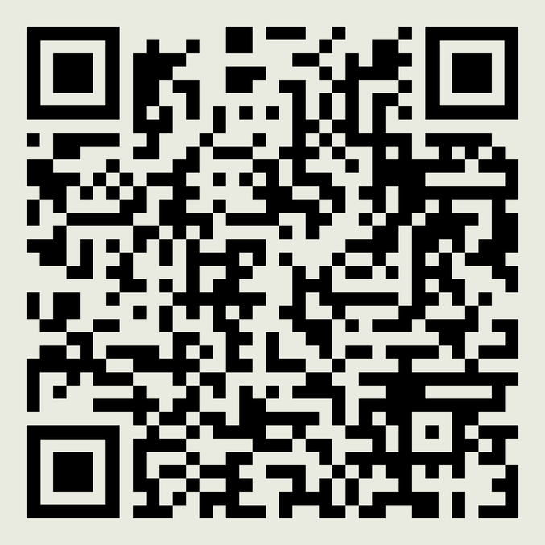
Thank you.
16

